Slide 1

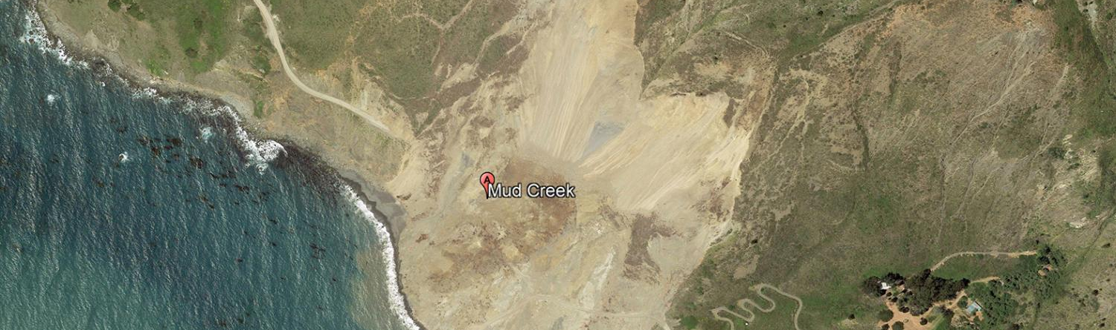
AI-POWERED LANDSLIDE REGION MAPPING USING SEMANTIC SEGMENTATION
Suraj Karki
04.09.2025
Dr.-Ing. Constanze Schwan
Notes:
HAW

Slide 2
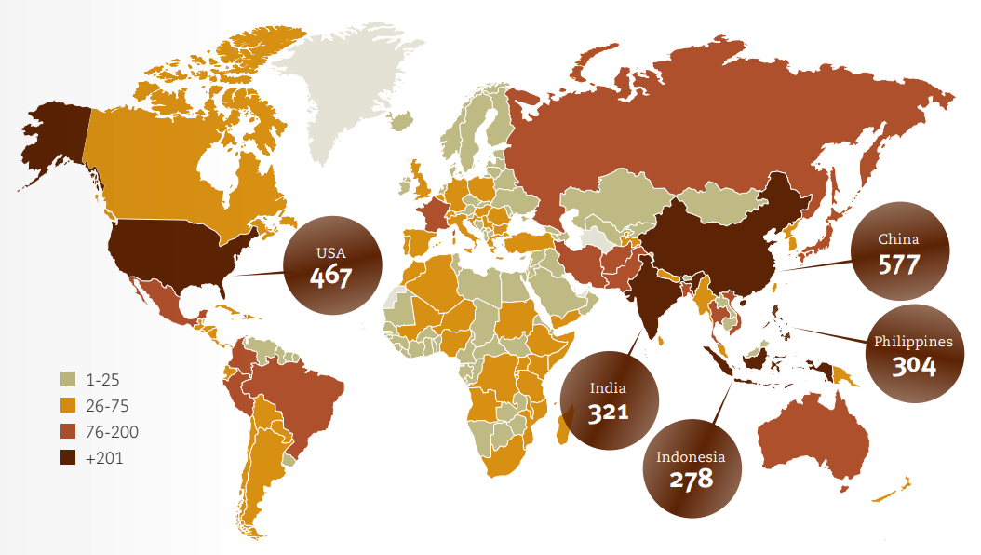
Introduction
Landslides are one of the most common and dangerous natural disasters globally.
It causes significant damage to infrastructure, agriculture, and human life.
According to the UNDRR, over 4,000 people die each year globally due to landslides. ¹
Rapid post-disaster mapping is vital for guiding rescue efforts and risk assessment.
1. UNDRR, Human Cost of Disasters: An Overview of the Last 20 Years (2000–2019), United Nations Office for Disaster Risk Reduction, 2020. [Online]. Available: https://www.undrr.org/publication/human-cost-disasters-overview-last-20-years-2000-2019
AI-Powered Landslide Region Mapping using Semantic Segmentation | Hochschule Bielefeld | 04.09.2025 | Page 2
Notes:
HAW

Slide 3
Problem statement
Manual mapping of landslide areas in post landslide assessment is slow, inconsistent, and risky.
Precise, up-to-date landslide masks are needed for:
Damage assessment
Recovery planning
Updating geohazards maps
A system is required to automatically generate post-landslide maps.
AI-Powered Landslide Region Mapping using Semantic Segmentation | Hochschule Bielefeld | 04.09.2025 | Page 3
Notes:
HAW

Slide 4
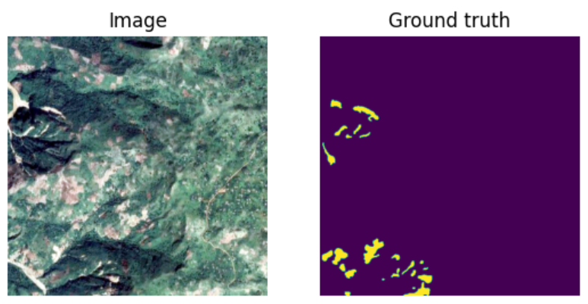
objective
To develop a deep learning model for precise landslide mapping
To obtain high performance in segmenting landslide regions from satellite and UAV imagery
To enable real-time monitoring and support disaster management efforts
Figure Source: Zhao et al. (2023), A global dataset of landslide inventories compiled from satellite imagery. Scientific Data. https://doi.org/10.1038/s41597-023-02847-z
AI-Powered Landslide Region Mapping using Semantic Segmentation | Hochschule Bielefeld | 04.09.2025 | Page 4
Notes:
HAW

Slide 5
State of the art
Landslide Detection and Segmentation using Remote Sensing Images and Deep Neural Network ²
Dataset: Landslide4Sense (128x128 pixels;14 channels)
Approaches:
Enhanced U-net structure with residual-convolutional layers
Custom multi-head attention layer (Pro-Att) to focus on landslide regions
Multi-resolution segmentation outputs: at 64×64, 128×128, and 256×256 (ensembled)
Generate 12 additional bands to improve input data
Combined focal loss and IoU loss as loss function (handle class imbalance)
It achieved an mIoU of 76.07 and F1-score of 84.07, surpassing the baseline.
2. C. Le, L. Pham, J. Lampert, M. Schlögl, and A. Schindler, “Landslide detection and segmentation using remote sensing images and deep neural network,” arXiv preprint arXiv:2312.16717, 2023. [Online]. Available: https://arxiv.org/abs/2312.16717
AI-Powered Landslide Region Mapping using Semantic Segmentation | Hochschule Bielefeld | 04.09.2025 | Page 5
Notes:
HAW

Slide 6
State of the art
LandslideSegNet: an effective deep learning network for landslide segmentation using remote sensing imagery ³
Dataset: Landslide4Sense Modified (256x256;3 channels)
Approaches:
Proposed LandslideSegNet, a custom architecture for landslide segmentation.
It contains Encoder-decoder Residual Block, enhances feature extraction by combining local and contextual information.
And, Hybrid Attentional Atrous Convolution Module improves efficiency by focusing on critical features and suppressing irrelevant information.
3. Şener, A., Ergen, B. LandslideSegNet: an effective deep learning network for landslide segmentation using remote sensing imagery. Earth Sci Inform 17, 3963–3977 (2024). https://doi.org/10.1007/s12145-024-01434-z
AI-Powered Landslide Region Mapping using Semantic Segmentation | Hochschule Bielefeld | 04.09.2025 | Page 6
Notes:
HAW

Slide 7
State of the art
LandslideSegNet: an effective deep learning network for landslide segmentation using remote sensing imagery ³
It achieved an mIoU of 73.65 and precision of 71.48.
3. Şener, A., Ergen, B. LandslideSegNet: an effective deep learning network for landslide segmentation using remote sensing imagery. Earth Sci Inform 17, 3963–3977 (2024). https://doi.org/10.1007/s12145-024-01434-z
AI-Powered Landslide Region Mapping using Semantic Segmentation | Hochschule Bielefeld | 04.09.2025 | Page 7
Notes:
HAW

Slide 8
State of the art
A landslide area segmentation method based on an improved UNet ⁴
Dataset: Bijie Landslide Dataset (3 channels, 770 landslide images and 2003 non-landslide)
Approaches:
Enhanced U-net structure with dilated convolution and EMA attention.
Dilated convolution enlarges the receptive field and capture richer contextual information.
EMA attention helps with multi-scale feature extraction.
The proposed Pag module(skip conn.) enhances multi-scale feature fusion, improving transmission and reducing pixel information loss caused when resolution changes in U-Net.
It achieved an mIoU of 83.85 and precision of 80.26.
4. Li, G., Li, K., Zhang, G. et al. A landslide area segmentation method based on an improved UNet. Sci Rep 15, 11852 (2025). https://doi.org/10.1038/s41598-025-94039-5
AI-Powered Landslide Region Mapping using Semantic Segmentation | Hochschule Bielefeld | 04.09.2025 | Page 8
Notes:
HAW

Slide 9
State of the art
TransLandSeg: A Transfer Learning Approach for Landslide Semantic Segmentation Based on Vision Foundation Model ⁵
Dataset: Bijie Landslide Dataset and Landslide4Sense
Approaches:
Proposed a custom architecture, based on Segment Anything Model (SAM).
Applies Adaptive Transfer Learning (ATL) to adapt SAM’s segmentation capabilities for landslide semantic segmentation.
Image Encoder and Mask Decoder
ATL fine-tuning layer inserted between Transformer blocks that learns landslide-specific features.
5. C. Hou et al., "A Transfer Learning Approach for Landslide Semantic Segmentation Based on Visual Foundation Model," in IEEE Journal of Selected Topics in Applied Earth Observations and Remote Sensing, vol. 18, pp. 11561-11572, 2025, doi: 10.1109/JSTARS.2025.3559884.
AI-Powered Landslide Region Mapping using Semantic Segmentation | Hochschule Bielefeld | 04.09.2025 | Page 9
Notes:
HAW

Slide 10
State of the art
TransLandSeg: A Transfer Learning Approach for Landslide Semantic Segmentation Based on Vision Foundation Model ⁵
It achieved an mIoU of 88.10 and precision of 93.14 on bijie dataset.
It achieved an mIoU of 75.99 and precision of 84.99 on landslide4sense dataset.
5. C. Hou et al., "A Transfer Learning Approach for Landslide Semantic Segmentation Based on Visual Foundation Model," in IEEE Journal of Selected Topics in Applied Earth Observations and Remote Sensing, vol. 18, pp. 11561-11572, 2025, doi: 10.1109/JSTARS.2025.3559884.
AI-Powered Landslide Region Mapping using Semantic Segmentation | Hochschule Bielefeld | 04.09.2025 | Page 10
Notes:
HAW

Slide 11
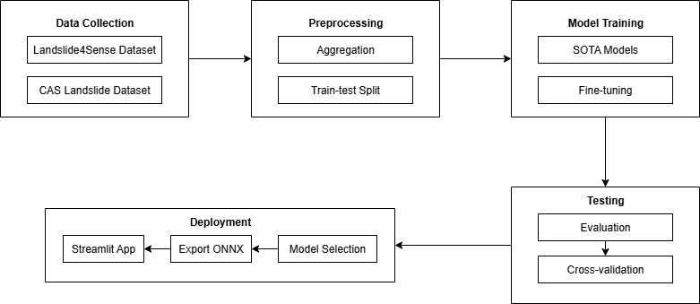
workflow
General steps include: data collection, pre-processing, model training, testing, and deployment.
The overall workflow of the project is illustrated in the figure below.
AI-Powered Landslide Region Mapping using Semantic Segmentation | Hochschule Bielefeld | 04.09.2025 | Page 11
Notes:
HAW

Slide 12
Data acquisition
Landslide4Sense Dataset ⁶
Source: Institute of Advanced Research in Artificial Intelligence (IARAI)
Regions: Collected from four regions (Iburi, Kodagu, Rasuwa, Taitung)
Include earthquake and rainfall triggers landslide
Satellite: Sentinel-2
Topographic: ALOS (Advanced Land Observing Satellite
Acquisition Process: Data aggregated from public satellite archives
Annotation Process: annotations via Object-Based Image Analysis (OBIA)
6. O. Ghorbanzadeh et al., "Landslide4Sense: Reference benchmark data and deep learning models for landslide detection," IEEE Trans. Geosci. Remote Sens., vol. 60, pp. 1–17, 2022, doi: 10.1109/TGRS.2022.3215209.
AI-Powered Landslide Region Mapping using Semantic Segmentation | Hochschule Bielefeld | 04.09.2025 | Page 12
Notes:
HAW

Slide 13
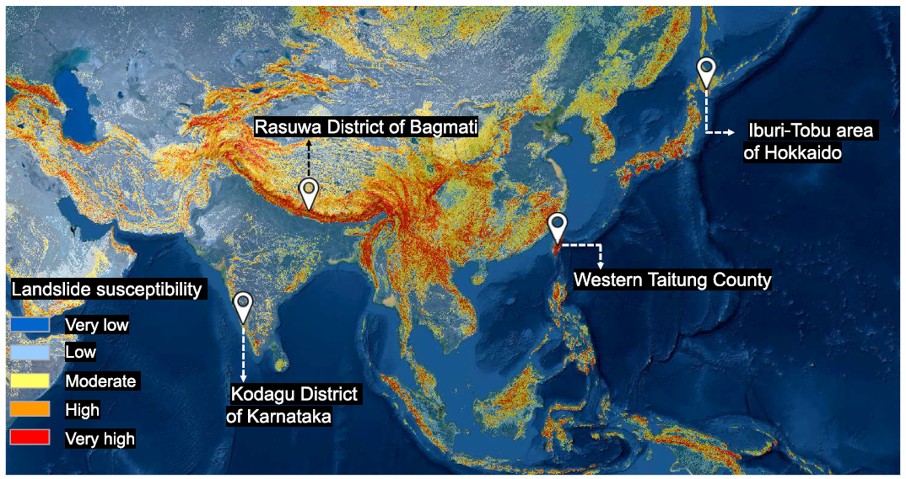
Data acquisition
Landslide4Sense Dataset ⁶
Geolocations of the selected case study areas shown on the global landslide susceptibility map.
6. O. Ghorbanzadeh et al., "Landslide4Sense: Reference benchmark data and deep learning models for landslide detection," IEEE Trans. Geosci. Remote Sens., vol. 60, pp. 1–17, 2022, doi: 10.1109/TGRS.2022.3215209.
AI-Powered Landslide Region Mapping using Semantic Segmentation | Hochschule Bielefeld | 04.09.2025 | Page 13
Notes:
HAW

Slide 14
Data acquisition
CAS Landslide Dataset ⁷
Source: Institute of Mountain Hazards and Environment, Chinese Academy of Sciences.
Regions: Collected from nine diverse region
Include earthquake and rainfall triggers landslide
Satellite: Sentinel-2, Landsat, WorldView2/3, Planet, SuperView-1, GF-1
UAV: High-resolution imagery from Sichuan Geomatics Center and partners.
Acquisition Process: Satellite data sourced via Google Earth Engine, Digital Globe, and authorized providers; UAV data collected through drone.
7. Y. Xu, C. Ouyang, Q. Xu, D. Wang, B. Zhao, and Y. Luo, "CAS Landslide Dataset: A large-scale and multisensor dataset for deep learning-based landslide detection," Sci. Data, vol. 11, no. 12, Jan. 2024, Art. no. 12, doi: 10.1038/s41597-023-02847-z.
AI-Powered Landslide Region Mapping using Semantic Segmentation | Hochschule Bielefeld | 04.09.2025 | Page 14
Notes:
HAW

Slide 15
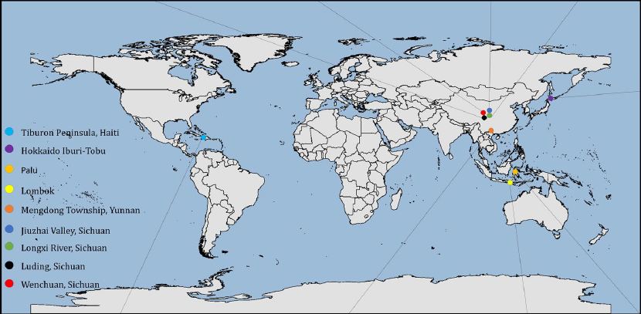
Data acquisition
Annotation Process
Pixel-level annotations created using QGIS and LabelMe.
guided by landslide inventories, verified by geologists, cross-checked by team
Figure Source: Y. Xu, C. Ouyang, Q. Xu, D. Wang, B. Zhao, and Y. Luo, "CAS Landslide Dataset: A large-scale and multisensor dataset for deep learning-based landslide detection," Sci. Data, vol. 11, no. 12, Jan. 2024, Art. no. 12, doi: 10.1038/s41597-023-02847-z.
AI-Powered Landslide Region Mapping using Semantic Segmentation | Hochschule Bielefeld | 04.09.2025 | Page 15
Notes:
HAW

Slide 16
Data structure
Landslide4Sense Dataset
Total Input: 3,799 images (128x128 pixels, 14 channels).
Channels: 12 Sentinel-2 bands (B1–B12), ALOS PALSAR slope (B13), DEM (B14).
Output: 128x128x1 binary mask
Split:
Training: 3,799, Validation: 245, Testing: 800
Distribution:
Train Set: 2,231 landslide, 1,568 non-landslide;
Valid Set: 146 landslide, 99 non-landslide;
Test Set: Test: 536 landslide, 264 non-landslide.
AI-Powered Landslide Region Mapping using Semantic Segmentation | Hochschule Bielefeld | 04.09.2025 | Page 16
Notes:
HAW

Slide 17
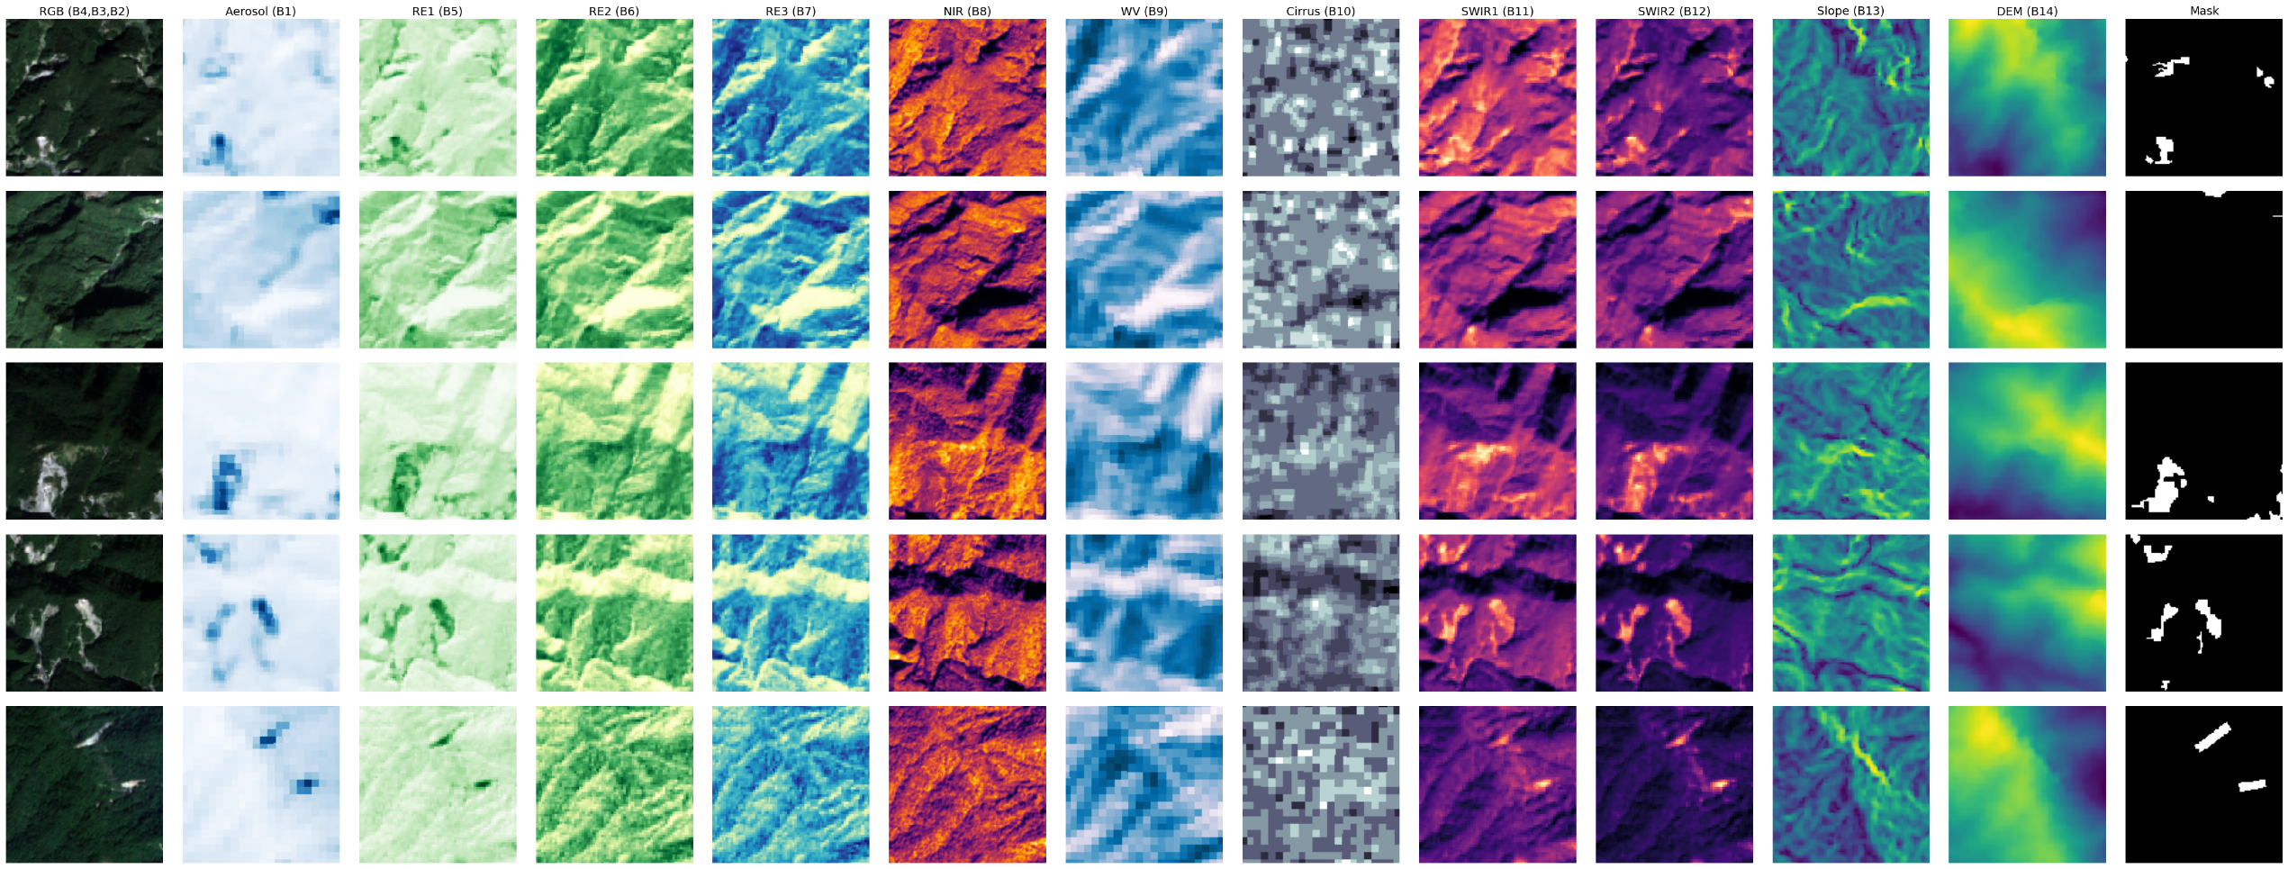
Data structure
Bands
AI-Powered Landslide Region Mapping using Semantic Segmentation | Hochschule Bielefeld | 04.09.2025 | Page 17
Notes:
HAW

Slide 18
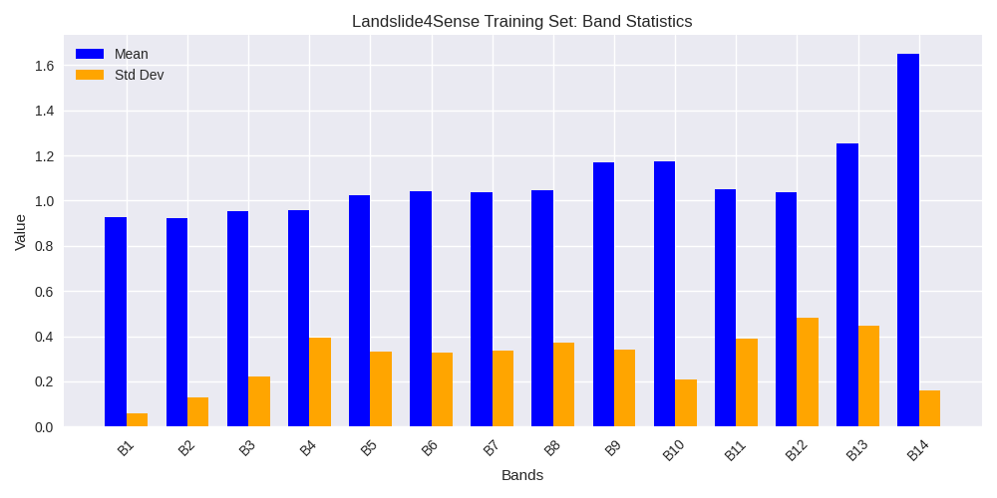
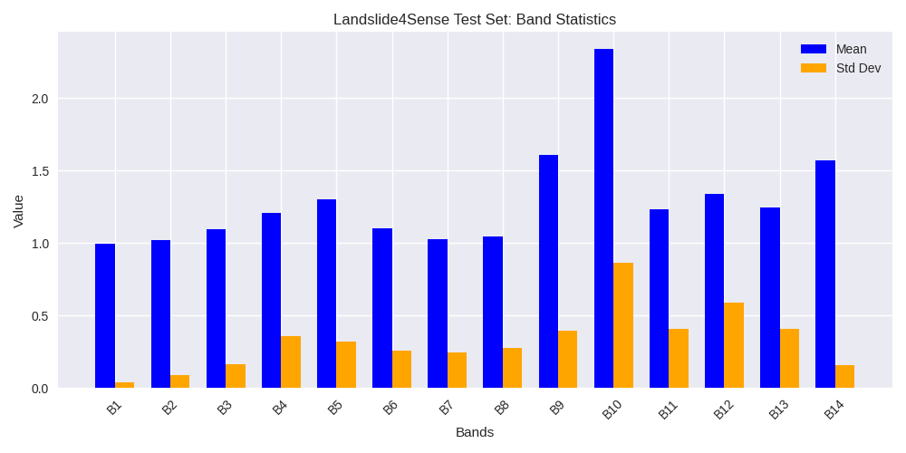
Data structure
Landslide4Sense Dataset
Band Statistics:
AI-Powered Landslide Region Mapping using Semantic Segmentation | Hochschule Bielefeld | 04.09.2025 | Page 18
Notes:
HAW

Slide 19
Data structure
CAS Landslide Dataset
Set 1: UAV
Total Inputs: 10,939 images (512x512 pixels, 3 channels)
Channels: RGB
Output: 512x512x1 binary mask
Split:
Training: 8,753, Validation: 1093, Testing: 1093
Distribution: All images have landslide region
AI-Powered Landslide Region Mapping using Semantic Segmentation | Hochschule Bielefeld | 04.09.2025 | Page 19
Notes:
HAW

Slide 20
Data structure
CAS Landslide Dataset
Set 2: Satellite
Total Inputs: 7,422 images (512x512 pixels, 3 channels)
Channels: RGB
Output: 512x512x1 binary mask
Split:
Training: 5,938, Validation: 742, Testing: 742
Distribution: All images have landslide region
AI-Powered Landslide Region Mapping using Semantic Segmentation | Hochschule Bielefeld | 04.09.2025 | Page 20
Notes:
HAW

Slide 21
Data structure
Detailed Information on CAS Landslide Dataset (UAV set)
Subdataset | Amount | Acquisition Time | Source | Sensor | Ground Resolution (m)
Moxitaidi | 984 | 2022.09–2022.10 | Sichuan Geomatics Center | UAV | 0.6
Moxitaidi | 483 | 2022.09–2022.10 | Sichuan Geomatics Center | UAV | 1
Moxi Town | 1635 | 2022.09–2022.10 | Sichuan Geomatics Center | UAV | 0.2
Moxi Town | 160 | 2022.09–2022.10 | Sichuan Geomatics Center | UAV | 1
Longxi River | 2504 | 2011.03–2011.05 | Sichuan Geomatics Center | UAV | 0.5
Jiuzhai Valley | 5925 | 2017.08–2017.09 | Sichuan Geomatics Center | UAV | 0.2
Jiuzhai Valley | 1752 | 2017.08–2017.09 | Sichuan Geomatics Center | UAV | 0.5
AI-Powered Landslide Region Mapping using Semantic Segmentation | Hochschule Bielefeld | 04.09.2025 | Page 21
Notes:
HAW

Slide 22
Data structure
Detailed Information on CAS Landslide Dataset (Satellite set)
Subdataset | Amount | Acquisition Time | Source | Sensor | Ground Resolution (m)
Palu | 817 | 2021.01–2021.11 | Digital Globe Open Data Program | WorldView2/3 | 5
Lombok | 436 | 2019.05–2019.12 | Digital Globe Open Data Program | WorldView2/3 | 5
Hokkaido Iburi-Tobu | 1484 | 2018.09–2018.10 | Geospatial Information Authority of Japan | SAT | 3
Tiburon Peninsula (Sentinel) | 606 | 2020.03–2020.06 | European Space Agency | Sentinel-2/L2A | 5
Tiburon Peninsula (Planet) | 325 | 2021.09–2021.12 | Planet | Planet | 4
Mengdong | 1155 | 2018.11.04 | Beijing Lanyu Fangyuan Technology Co., Ltd. | SuperView-1 | 0.5
Moxitaidi (SAT) | 652 | 2022.09–2022.10 | European Space Agency | Sentinel-2/L2A | 0.6
Longxi River (SAT) | 1769 | 2015.03–2015.12 | China Centre for Resources Satellite Data and Application | GF-1 | 0.5
Wenchuan | 178 | 2008.11–2008.12 | U.S. Geological Survey | Landsat | 5
AI-Powered Landslide Region Mapping using Semantic Segmentation | Hochschule Bielefeld | 04.09.2025 | Page 22
Notes:
HAW

Slide 23
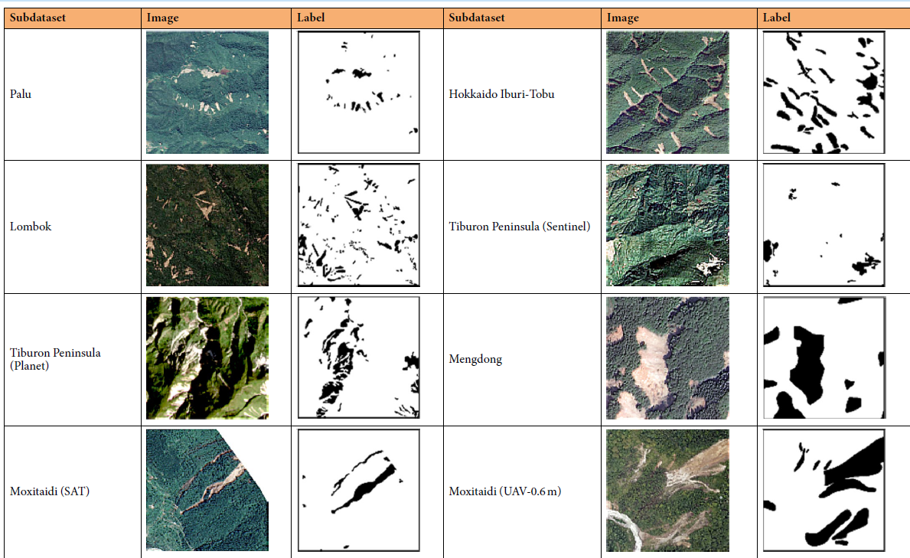
Data structure
Images and Labels of Samples from the Subdatasets of the CAS Landslide Dataset.
Figure Source: Y. Xu, C. Ouyang, Q. Xu, D. Wang, B. Zhao, and Y. Luo, "CAS Landslide Dataset: A large-scale and multisensor dataset for deep learning-based landslide detection," Sci. Data, vol. 11, no. 12, Jan. 2024, Art. no. 12, doi: 10.1038/s41597-023-02847-z.
AI-Powered Landslide Region Mapping using Semantic Segmentation | Hochschule Bielefeld | 04.09.2025 | Page 23
Notes:
HAW

Slide 24
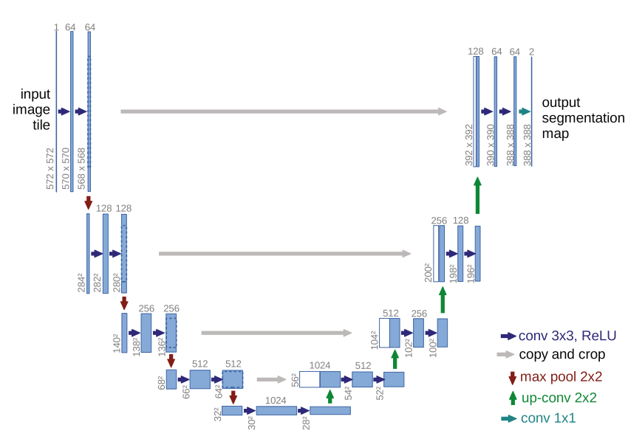
ML models
1. Unet
A FCN originally designed for biomedical image segmentation.
Widely used in remote sensing for image classification and
object detection, including landslide detection.
Encoder: Captures low-level features
Decoder: Captures high-level features and reconstructs image
Skip Connections: preserve fine-grained details and improve
accuracy.
Source: O. Ronneberger, P. Fischer, and T. Brox, “U-Net: Convolutional networks for biomedical image segmentation,” in Proc. Int. Conf. Med.
Image Comput.-Assist. Intervent. Cham, Switzerland: Springer, 2015, pp. 234–241.
AI-Powered Landslide Region Mapping using Semantic Segmentation | Hochschule Bielefeld | 04.09.2025 | Page 24
Notes:
HAW

Slide 25
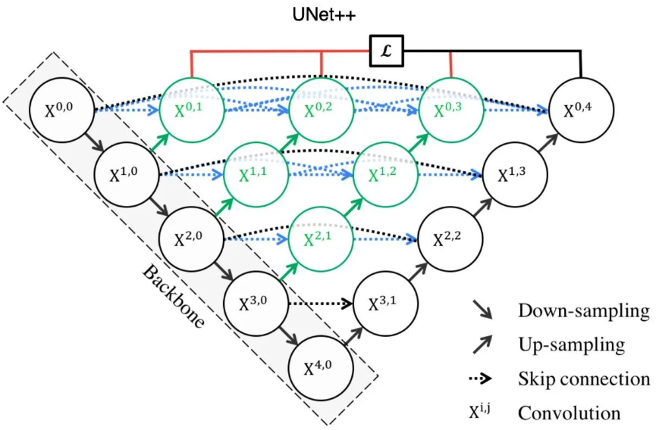
ML models
2. Unet++
An improved version of U-Net.
redesigned skip pathways (shown in green): bridges the
semantic gap between encoder and decoder
dense skip connections (shown in blue)
deep supervision (shown in red): allows pruning to trade off speed and accuracy by using multiple output branches.
Enhances feature fusion for improved accuracy and gradient flow.
Source: https://jinglescode.github.io/2019/12/02/biomedical-image-segmentation-u-net-nested/
AI-Powered Landslide Region Mapping using Semantic Segmentation | Hochschule Bielefeld | 04.09.2025 | Page 25
Notes:
HAW

Slide 26
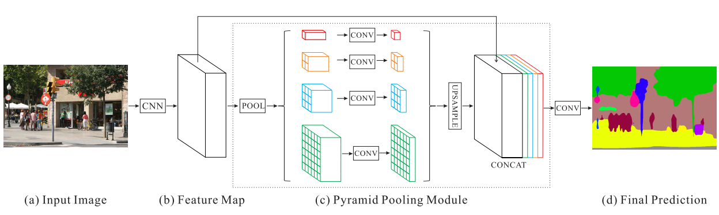
ML models
3. PSPNet
Uses pyramid pooling to learn global context information.
Applies regional aggregation to capture multi-scale
features.
Fuses features from four different pyramid scales
Achieves effective multi-scale feature learning
Can able to efficiently work with variable size objects of the image
Source: H. Zhao, J. Shi, X. Qi, X. Wang and J. Jia, "Pyramid Scene Parsing Network," 2017 IEEE Conference on Computer Vision and Pattern Recognition (CVPR), Honolulu, HI, USA, 2017, pp. 6230-6239, doi: 10.1109/CVPR.2017.660.
AI-Powered Landslide Region Mapping using Semantic Segmentation | Hochschule Bielefeld | 04.09.2025 | Page 26
Notes:
HAW

Slide 27
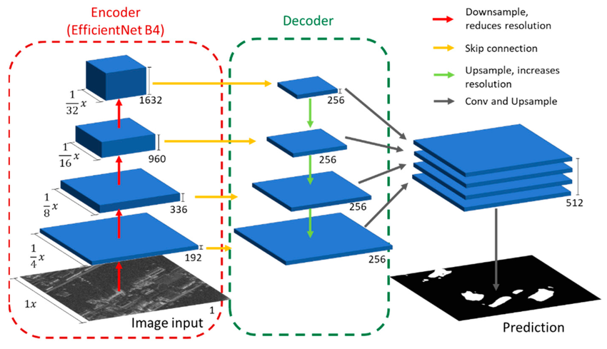
ML models
4. FPN
Designed for multi-scale segmentation
Builds a top-down feature pyramid from deep to shallow
layers
Combines low-resolution semantic-rich features
with high-resolution spatial-rich features
Enhances segmentation of small, medium, and large objects
Source: Wangiyana, Sandhi & Samczynski, Piotr & Gromek, Artur. (2022). Data Augmentation for Building Footprint Segmentation in SAR Images: An Empirical Study. Remote Sensing. 14. 2012. 10.3390/rs14092012.
AI-Powered Landslide Region Mapping using Semantic Segmentation | Hochschule Bielefeld | 04.09.2025 | Page 27
Notes:
HAW

Slide 28
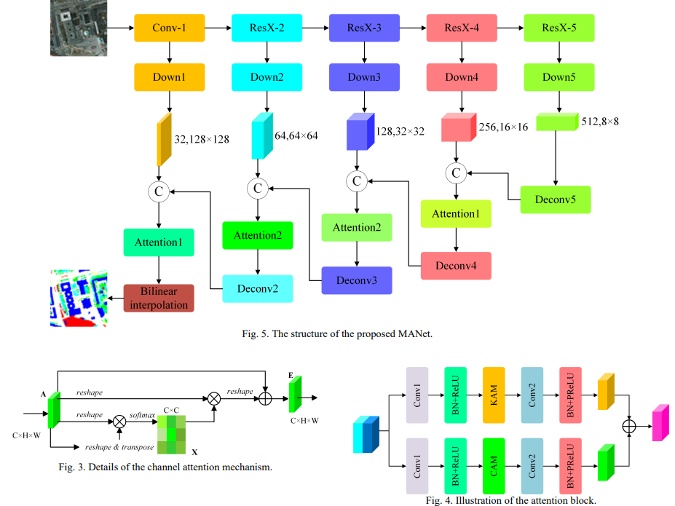
ML models
5. MANet
Focuses on fine-grained semantic segmentation
Utilizes multi-scale feature extraction for diverse
object sizes
Incorporates attention mechanisms to highlight
important regions
Enhances boundary details and small object recognition
Suitable for complex and cluttered scenes like satellite images
Source: R. Li, S. Zheng, C. Zhang, C. Duan, J. Su, L. Wang, and P. M. Atkinson, “Multiattention Network for Semantic Segmentation of Fine-Resolution Remote Sensing Images,” IEEE Transactions on Geoscience and Remote Sensing, vol. 60, pp. 1–13, 2022, doi: 10.1109/TGRS.2021.3093977.
AI-Powered Landslide Region Mapping using Semantic Segmentation | Hochschule Bielefeld | 04.09.2025 | Page 28
Notes:
HAW

Slide 29
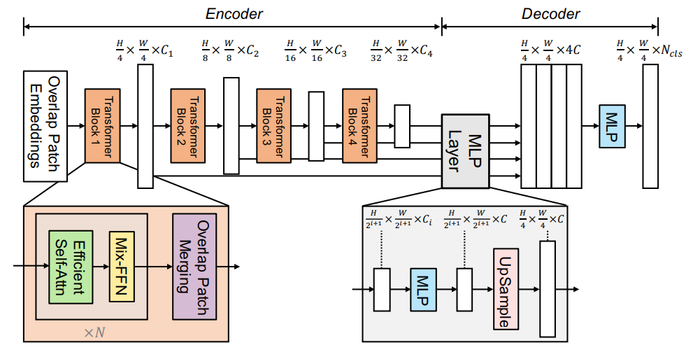
ML models
6. Segformer
Transformer-based architecture for semantic segmentation
Hierarchical Transformer encoder: extract coarse
and fine features
Lightweight MLP decoder: directly fuse these multi-level
features and predict the semantic segmentation mask
Achieves strong accuracy–efficiency trade-off for high-resolution images
FFN: Feed-forward Network
Source: E. Xie, W. Wang, Z. Yu, A. Anandkumar, J. M. Alvarez, and P. Luo, “SegFormer: Simple and Efficient Design for Semantic Segmentation with Transformers,” arXiv preprint arXiv:2105.15203, 2021. [Online]. Available: https://arxiv.org/abs/2105.15203
AI-Powered Landslide Region Mapping using Semantic Segmentation | Hochschule Bielefeld | 04.09.2025 | Page 29
Notes:
HAW

Slide 30
fine-tuning
Fine-tuning is decided based on the available hardware resources, datasets, and project timeframe
Approach:
Used pre-trained encoders: by freezing the encoder weights (imagenet)
Resnet 18, Resnet34, Resnet50
Mobilenet V2
Densenet 161
Efficientnet-b2
Xception
Decoder part of the model is fine-tuned
AI-Powered Landslide Region Mapping using Semantic Segmentation | Hochschule Bielefeld | 04.09.2025 | Page 30
Notes:
HAW

Slide 31



fine-tuning
Experimental Setup
Hardware:
DA-Cluster: 8 CUDA-capable GPUs (NVIDIA Tesla P100, each with 12 GB)
Software:
Segmentation Models: Pytorch based library to build and train segmentatinon models
Streamlit: Python library to build interactive web apps
AI-Powered Landslide Region Mapping using Semantic Segmentation | Hochschule Bielefeld | 04.09.2025 | Page 31
Notes:
HAW

Slide 32
fine-tuning
Experimental Setup
Hyperparameters:
Batch Size: 8, 32
Learning Rate: 0.001 (Adam optimizer, LRscheduler: Cosine Annealing )
Number of Epochs: 300
Loss Function: Focal Loss
Early Stopping to avoid overfitting
Complete code for training, evaluation, and deployment is available in the following GitHub repository:
https://github.com/surajkarki66/AI-Powered_Landslide_Region_Mapping_using_Semantic_Segmentation
AI-Powered Landslide Region Mapping using Semantic Segmentation | Hochschule Bielefeld | 04.09.2025 | Page 32
Notes:
HAW

Slide 33
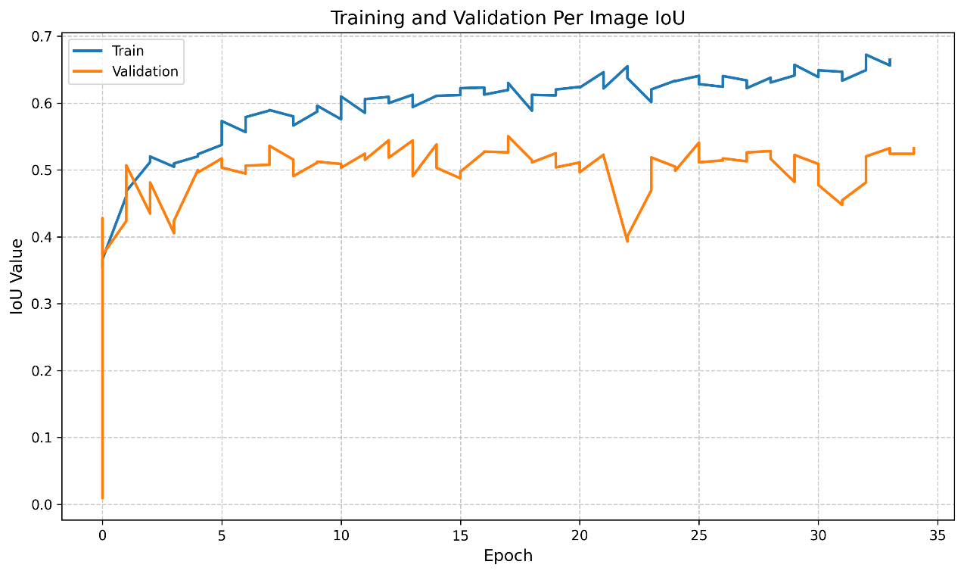
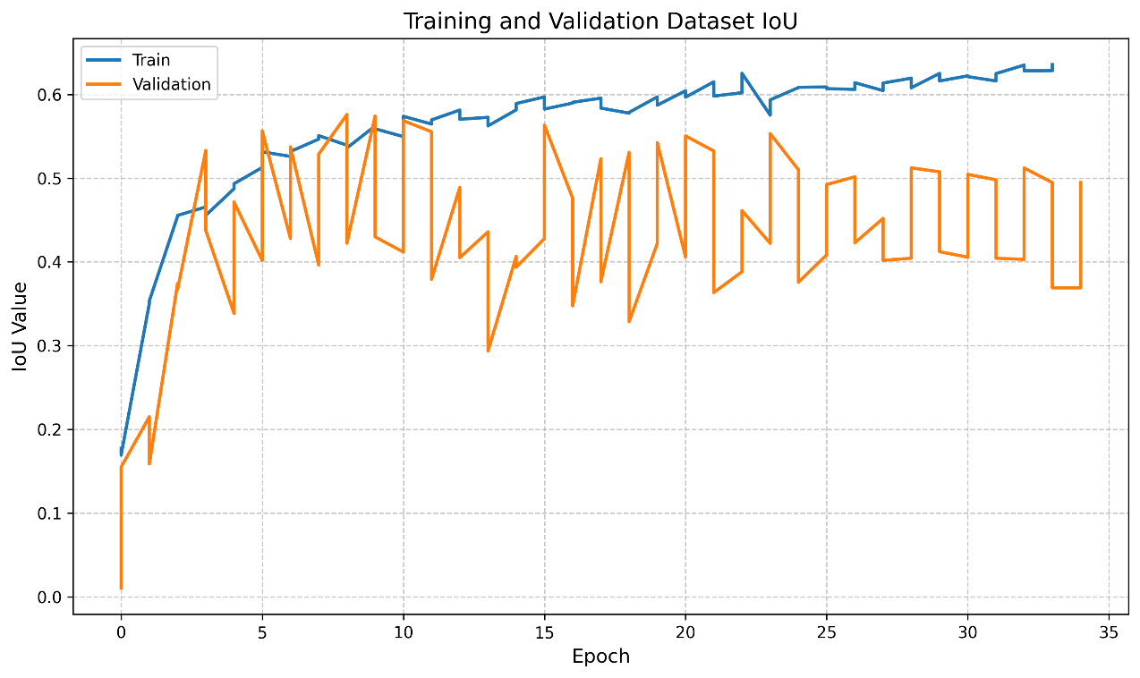
Training Results – landslide4sense dataset
Dataset and Per Image IoU of Unet with MobilenetV2 encoder, which is best performing model
AI-Powered Landslide Region Mapping using Semantic Segmentation | Hochschule Bielefeld | 04.09.2025 | Page 33
Notes:
HAW

Slide 34
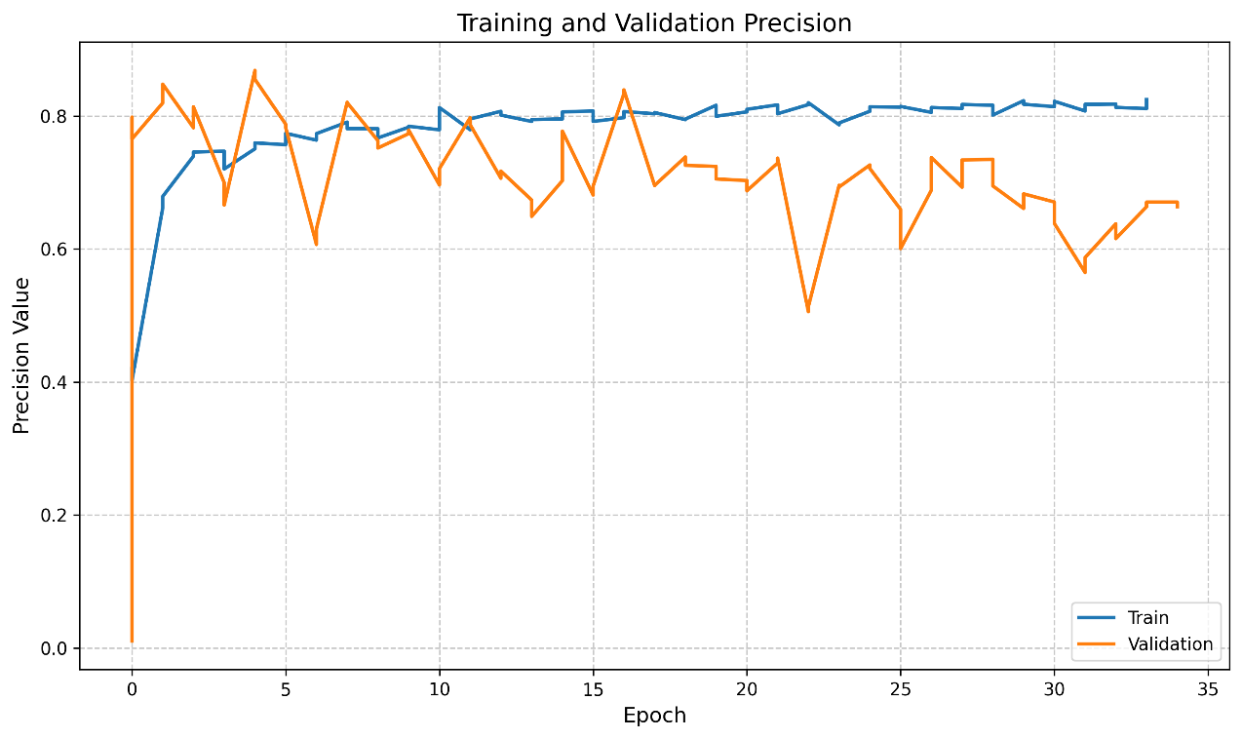
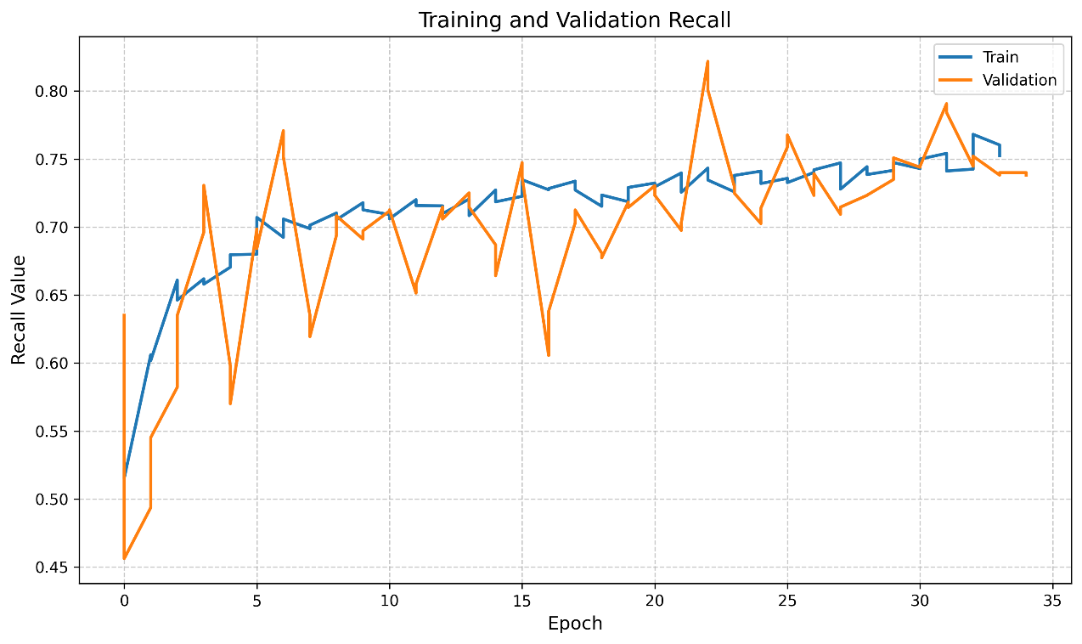
Training Results – landslide4sense dataset
Precision and recall of Unet with MobilenetV2 encoder, which is best performing model
AI-Powered Landslide Region Mapping using Semantic Segmentation | Hochschule Bielefeld | 04.09.2025 | Page 34
Notes:
HAW

Slide 35
Evaluation Results – landslide4sense dataset
Architecture | Backbone | Per-Image IoU | Dataset IoU | F1 Score | Accuracy | Recall | Precision
FPN | MobileNet | 0.4419 | 0.4041 | 0.5756 | 0.9878 | 0.6212 | 0.6560
 | ResNet18 | 0.4321 | 0.4141 | 0.5857 | 0.9873 | 0.6349 | 0.6214
 | ResNet50 | 0.3906 | 0.3258 | 0.4915 | 0.9861 | 0.5522 | 0.6029
 | Xception | 0.3960 | 0.3122 | 0.4758 | 0.9857 | 0.6098 | 0.5842
MANet | Xception | 0.3934 | 0.3784 | 0.5490 | 0.9866 | 0.6159 | 0.6037
 | EfficientNet-B2 | 0.3451 | 0.3542 | 0.5231 | 0.9850 | 0.6267 | 0.5389
 | MobileNetV2 | 0.4232 | 0.4283 | 0.5998 | 0.9834 | 0.6796 | 0.6256
 | ResNet50 | 0.3319 | 0.3739 | 0.5443 | 0.9841 | 0.6928 | 0.5077
PSPNet | EfficientNet-B2 | 0.3855 | 0.3956 | 0.5669 | 0.9841 | 0.6219 | 0.5840
 | MobileNetV2 | 0.3896 | 0.3717 | 0.5419 | 0.9861 | 0.5940 | 0.5794
 | ResNet50 | 0.4074 | 0.3934 | 0.5646 | 0.9831 | 0.5971 | 0.6370
 | Xception | 0.3744 | 0.3541 | 0.5230 | 0.9862 | 0.5617 | 0.5930
 | DenseNet161 | 0.3974 | 0.4205 | 0.5920 | 0.9841 | 0.6042 | 0.6663
Segformer | ResNet18 | 0.4272 | 0.4132 | 0.5847 | 0.9873 | 0.6399 | 0.6226
 | ResNet34 | 0.4305 | 0.4120 | 0.5835 | 0.9845 | 0.6817 | 0.5924
UNet | DenseNet161 | 0.3192 | 0.4019 | 0.5734 | 0.9810 | 0.7495 | 0.4971
 | MobileNetV2 | 0.4444 | 0.4258 | 0.5973 | 0.9874 | 0.6996 | 0.6176
 | ResNet50 | 0.3619 | 0.4028 | 0.5743 | 0.9851 | 0.7218 | 0.5338
 | Xception | 0.4459 | 0.3536 | 0.5225 | 0.9814 | 0.6824 | 0.5856
UNet++ | MobileNetV2 | 0.4373 | 0.4018 | 0.5733 | 0.9875 | 0.6295 | 0.6423
 | Xception | 0.3149 | 0.3505 | 0.5191 | 0.9813 | 0.7496 | 0.4440
 | ResNet50 | 0.4215 | 0.3941 | 0.5654 | 0.9833 | 0.6272 | 0.6445
 | EfficientNet-B2 | 0.3659 | 0.4173 | 0.5888 | 0.9840 | 0.7141 | 0.5721
AI-Powered Landslide Region Mapping using Semantic Segmentation | Hochschule Bielefeld | 04.09.2025 | Page 35
Notes:
HAW

Slide 36
Evaluation Results – landslide4sense dataset
Best Performing Models (Top-2) on Landslide4Sense Dataset
Architecture | Backbone | Per-Image IoU | Dataset IoU | F1 Score | Accuracy | Recall | Precision
UNet | MobileNetV2 | 0.4444 | 0.4258 | 0.5973 | 0.9874 | 0.6996 | 0.6176
UNet | Xception | 0.4459 | 0.3536 | 0.5225 | 0.9814 | 0.6824 | 0.5856
10 Fold Cross Validation Result
Architecture | Backbone | Per-Image IoU | Dataset IoU | F1 Score | Accuracy | Recall | Precision
UNet | MobileNetV2 | 0.5898 | 0.5580 | 0.7208 | 0.9880 | 0.7248 | 0.7870
Due to large number of experiments; detailed results available at the link below.
https://drive.google.com/drive/folders/1kx3PE8OjQAdeSY55L-80fjDuaGewYr5C?usp=sharing
AI-Powered Landslide Region Mapping using Semantic Segmentation | Hochschule Bielefeld | 04.09.2025 | Page 36
Notes:
HAW

Slide 37
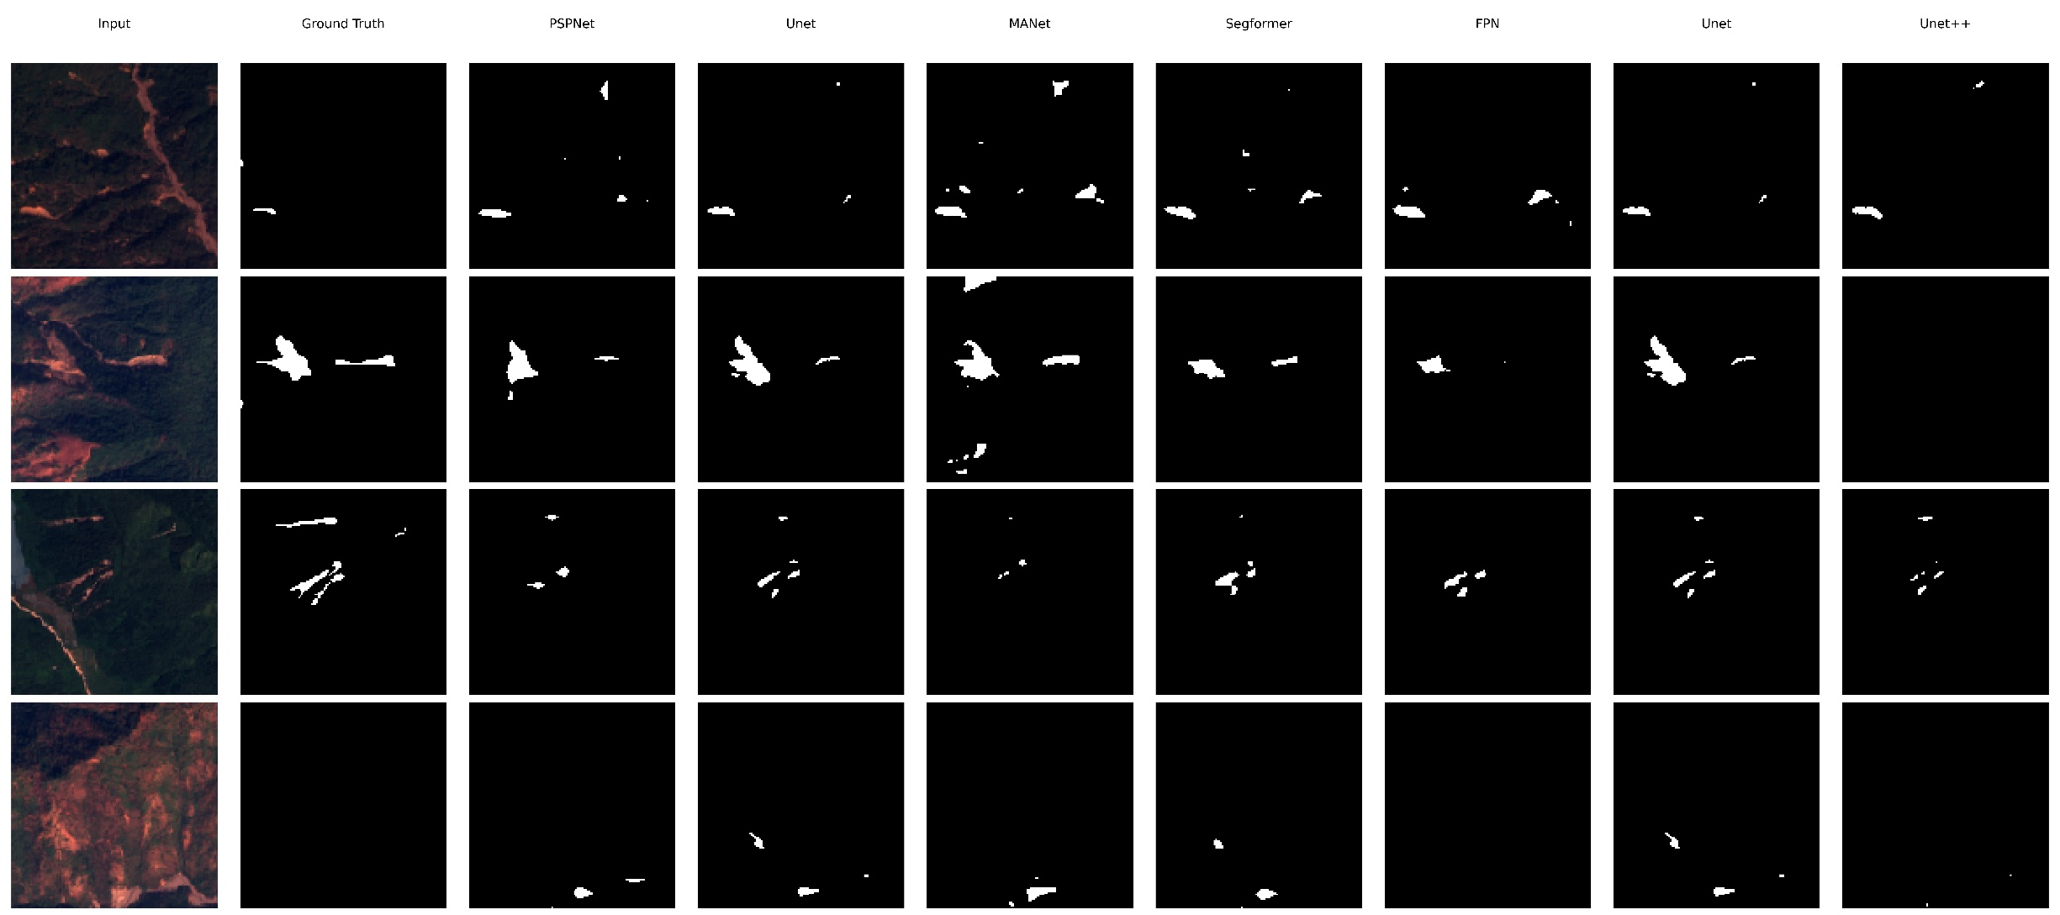
Sample predictions – landslide4sense dataset
AI-Powered Landslide Region Mapping using Semantic Segmentation | Hochschule Bielefeld | 04.09.2025 | Page 37
Notes:
HAW

Slide 38
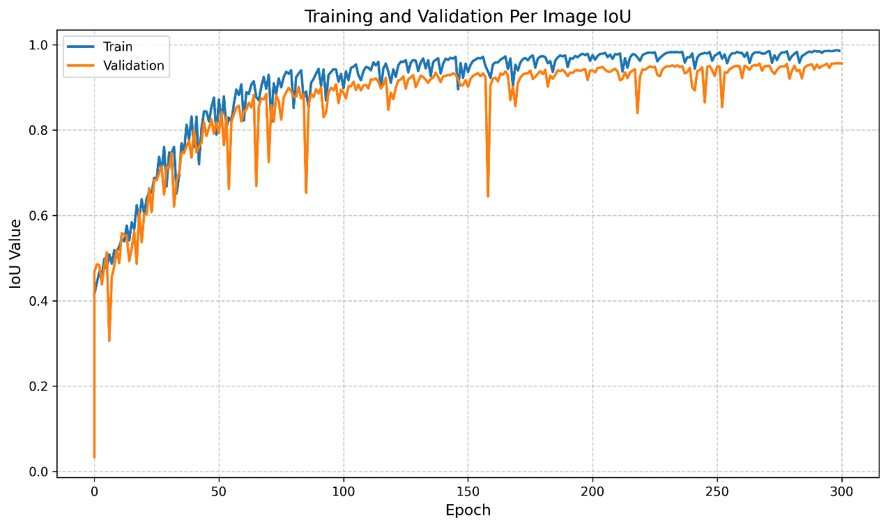
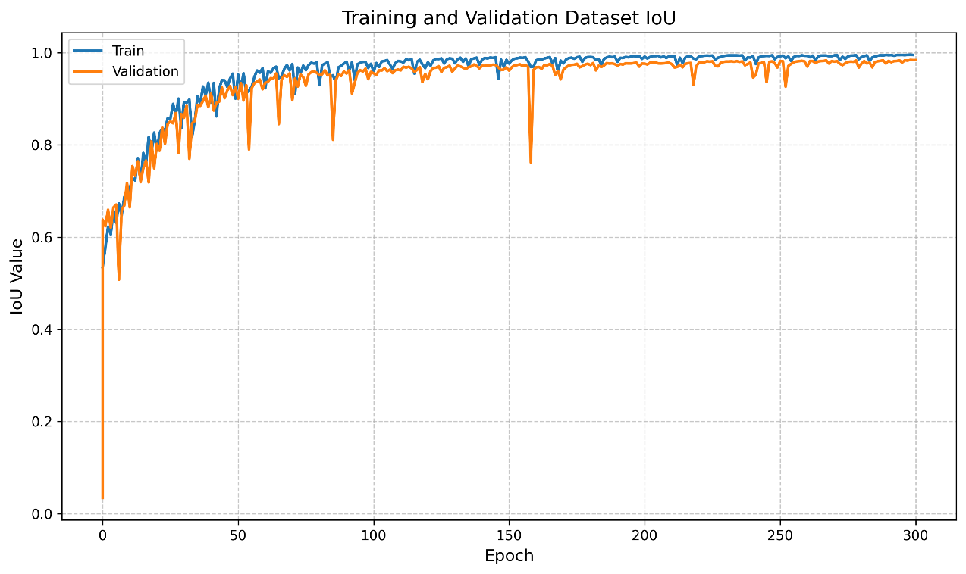
Training Results – CAS Landslide dataset (UAV)
Dataset and Per Image IoU of Unet++ with ResNet50 encoder, which is best performing model
AI-Powered Landslide Region Mapping using Semantic Segmentation | Hochschule Bielefeld | 04.09.2025 | Page 38
Notes:
HAW

Slide 39
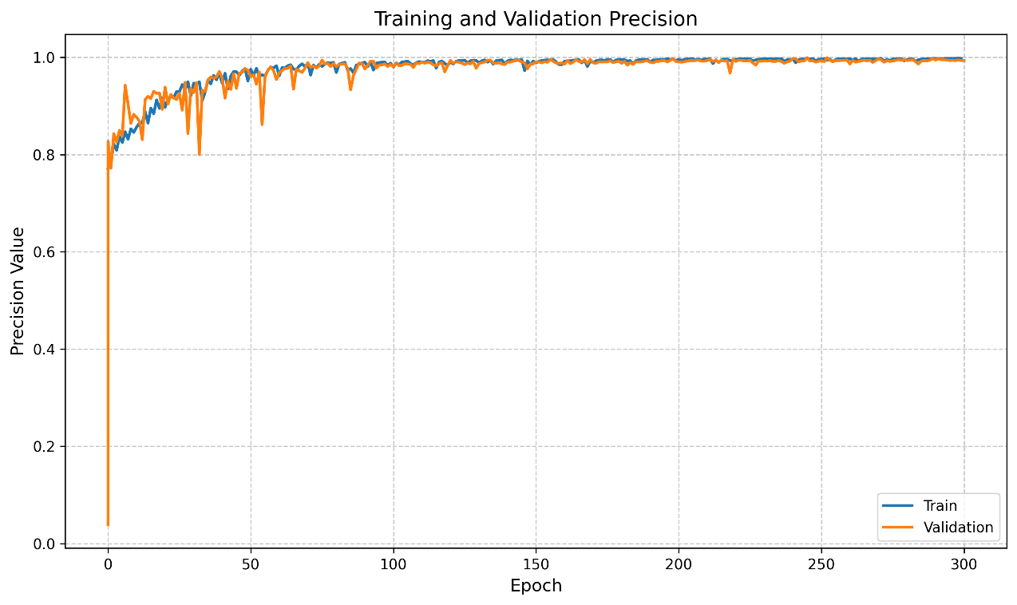
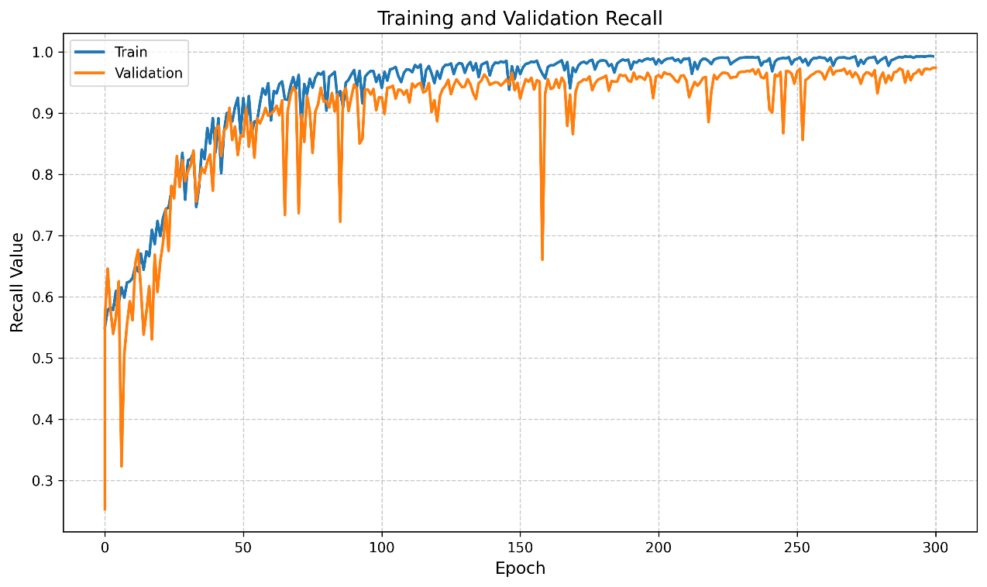
Training Results – CAS Landslide dataset (UAV)
Precision and recall of Unet++ with ResNet50 encoder, which is best performing model
AI-Powered Landslide Region Mapping using Semantic Segmentation | Hochschule Bielefeld | 04.09.2025 | Page 39
Notes:
HAW

Slide 40
Evaluation Results – CAS Landslide dataset (UAV)
Architecture | Backbone | Per-image IoU | Dataset IoU | F1 Score | Accuracy | Recall | Precision
FPN | MobileNet | 0.7986 | 0.9181 | 0.9573 | 0.9844 | 0.8606 | 0.9643
 | ResNet18 | 0.9002 | 0.9617 | 0.9805 | 0.9931 | 0.9386 | 0.9818
 | ResNet50 | 0.8895 | 0.9589 | 0.9790 | 0.9923 | 0.9237 | 0.9835
 | Xception | 0.9153 | 0.9720 | 0.9858 | 0.9950 | 0.9382 | 0.9882
MANet | Xception | 0.8171 | 0.9274 | 0.9623 | 0.9865 | 0.8359 | 0.9906
 | EfficientNet-B2 | 0.8628 | 0.9491 | 0.9739 | 0.9905 | 0.8930 | 0.9848
 | MobileNetV2 | 0.5350 | 0.6976 | 0.8218 | 0.9374 | 0.6456 | 0.8652
 | ResNet50 | 0.8842 | 0.9597 | 0.9795 | 0.9924 | 0.9199 | 0.9820
PSPNet | EfficientNet-B2 | 0.7487 | 0.8811 | 0.9368 | 0.9769 | 0.8499 | 0.9271
 | MobileNetV2 | 0.8230 | 0.9310 | 0.9643 | 0.9870 | 0.8583 | 0.9763
 | ResNet50 | 0.8105 | 0.9223 | 0.9596 | 0.9855 | 0.8645 | 0.9660
 | Xception | 0.7600 | 0.8916 | 0.9427 | 0.9782 | 0.8890 | 0.9163
Segformer | MobileNetV2 | 0.7387 | 0.8981 | 0.9463 | 0.9806 | 0.7845 | 0.9671
 | ResNet18 | 0.9042 | 0.9613 | 0.9803 | 0.9929 | 0.9453 | 0.9799
 | ResNet34 | 0.9140 | 0.9653 | 0.9823 | 0.9937 | 0.9372 | 0.9893
 | ResNet50 | 0.7020 | 0.8890 | 0.9412 | 0.9794 | 0.7085 | 0.9953
UNet | DenseNet161 | 0.8661 | 0.9485 | 0.9736 | 0.9903 | 0.9132 | 0.9794
 | MobileNetV2 | 0.8178 | 0.9274 | 0.9624 | 0.9862 | 0.8725 | 0.9707
 | ResNet50 | 0.9346 | 0.9732 | 0.9864 | 0.9951 | 0.9578 | 0.9888
 | Xception | 0.9290 | 0.9735 | 0.9866 | 0.9952 | 0.9468 | 0.9899
UNet++ | EfficientNet-B2 | 0.8592 | 0.9454 | 0.9719 | 0.9897 | 0.9022 | 0.9816
 | MobileNetV2 | 0.8181 | 0.9266 | 0.9619 | 0.9862 | 0.8642 | 0.9777
 | ResNet18 | 0.8981 | 0.9582 | 0.9787 | 0.9925 | 0.9298 | 0.9842
 | ResNet50 | 0.9519 | 0.9816 | 0.9907 | 0.9966 | 0.9676 | 0.9919
AI-Powered Landslide Region Mapping using Semantic Segmentation | Hochschule Bielefeld | 04.09.2025 | Page 40
Notes:
HAW

Slide 41
Evaluation Results – CAS Landslide dataset (UAV)
Best Performing Models (Top-2) on CAS Landslide Dataset (UAV Version)
Architecture | Backbone | Per-image IoU | Dataset IoU | F1 Score | Accuracy | Recall | Precision
UNet++ | ResNet50 | 0.9519 | 0.9816 | 0.9907 | 0.9966 | 0.9676 | 0.9919
UNet | ResNet50 | 0.9346 | 0.9732 | 0.9864 | 0.9951 | 0.9578 | 0.9888
5 Fold Cross Validation Result
Architecture | Backbone | Per-Image IoU | Dataset IoU | F1 Score | Accuracy | Recall | Precision
UNet++ | ResNet50 | 0.9456 | 0.9786 | 0.9893 | 0.9962 | 0.9654 | 0.9908
Due to large number of experiments; detailed results available at the link below.
https://drive.google.com/drive/folders/14RgcVSGZQITB6Kr225ZBBL_kVOwUb_L7?usp=sharing
AI-Powered Landslide Region Mapping using Semantic Segmentation | Hochschule Bielefeld | 04.09.2025 | Page 41
Notes:
HAW

Slide 42
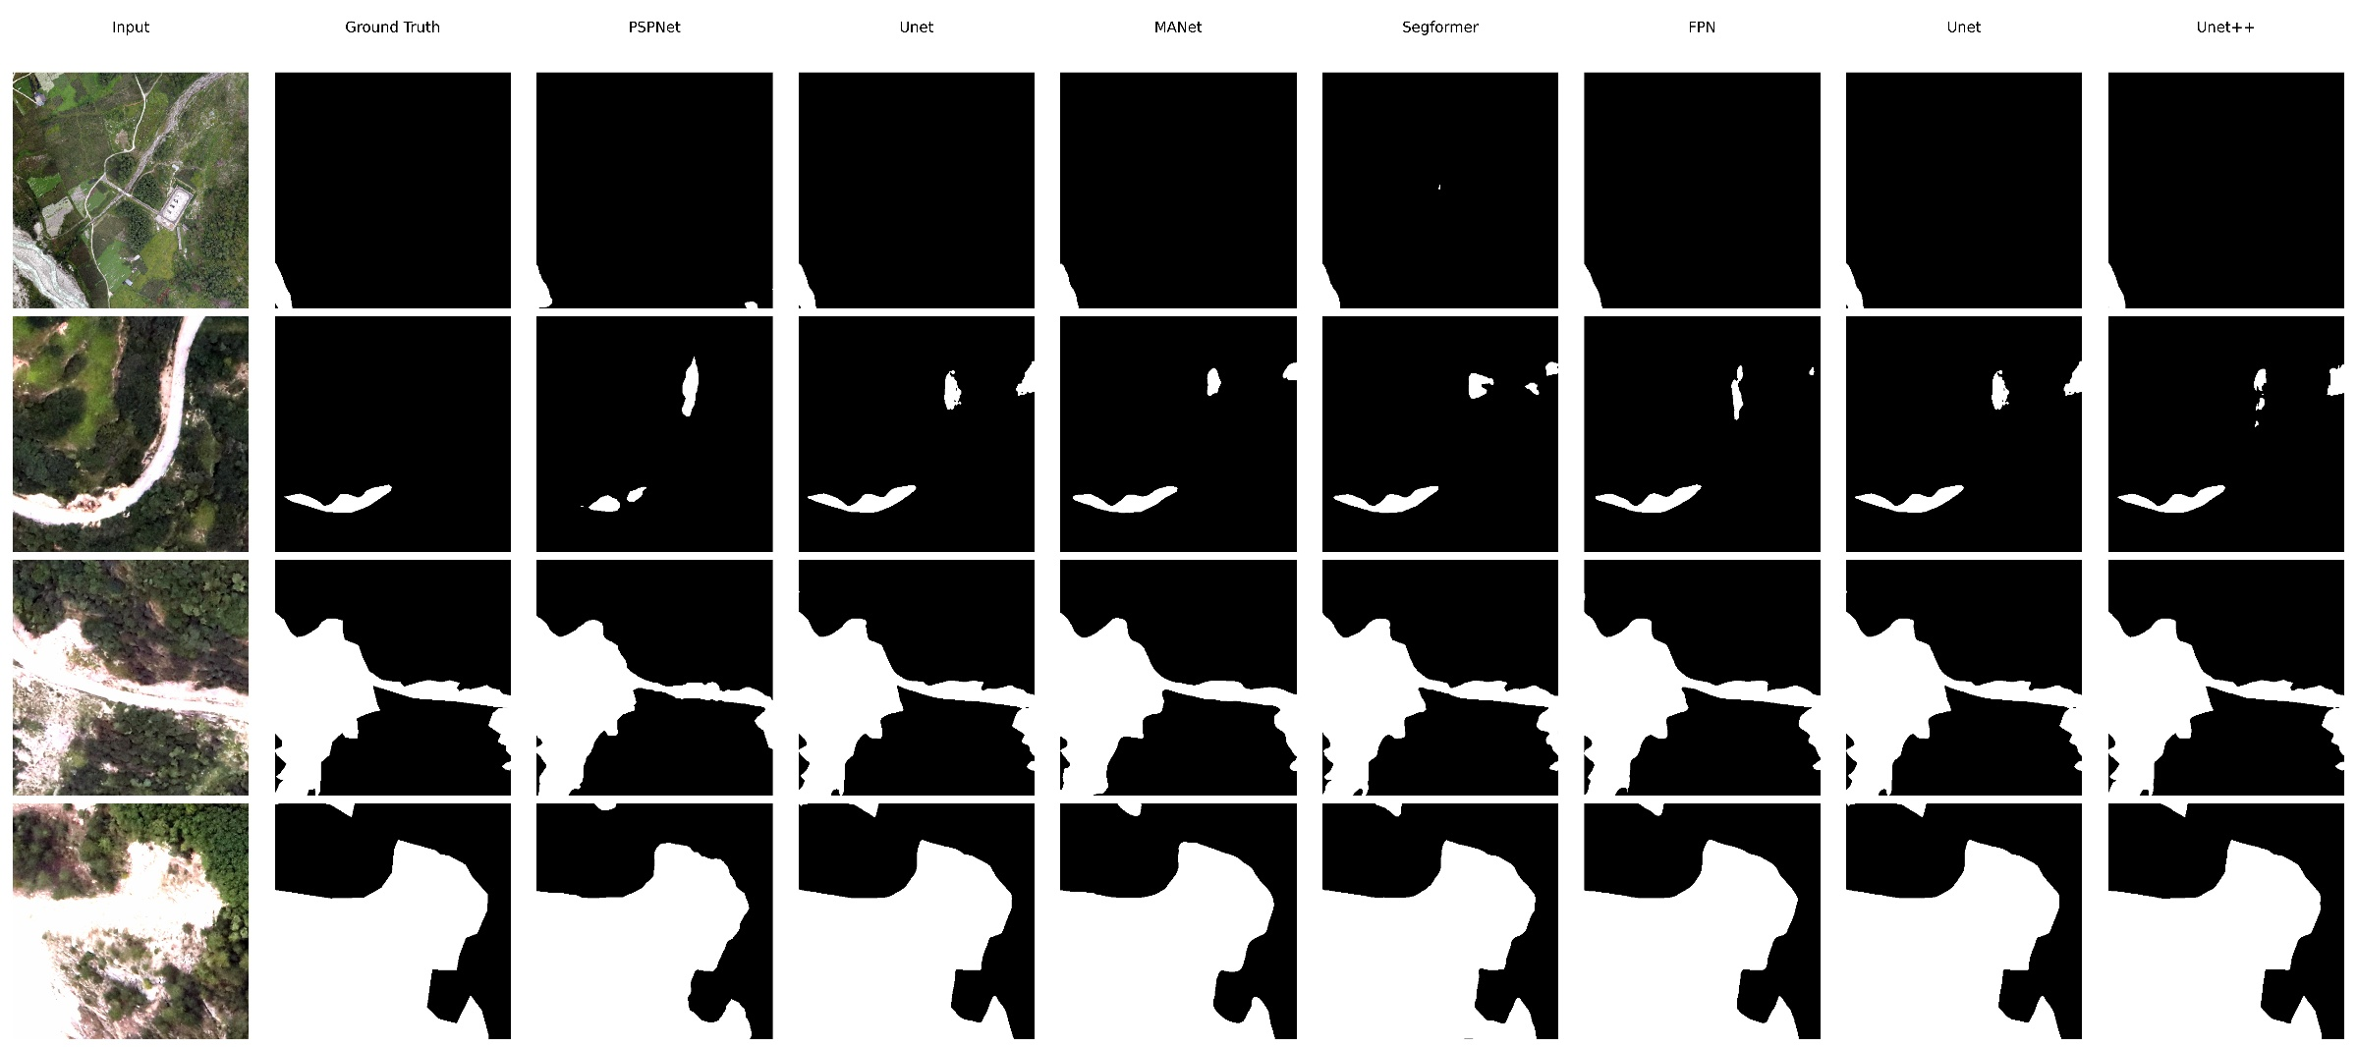
Sample predictions– CAS Landslide dataset (UAV)
AI-Powered Landslide Region Mapping using Semantic Segmentation | Hochschule Bielefeld | 04.09.2025 | Page 42
Notes:
HAW

Slide 43
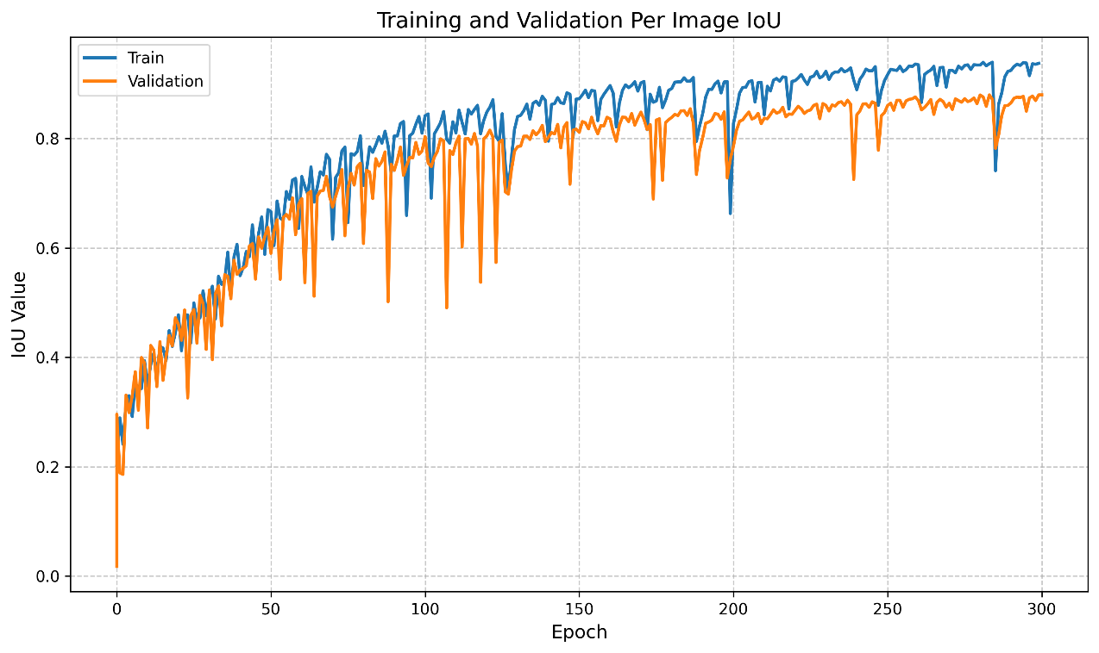
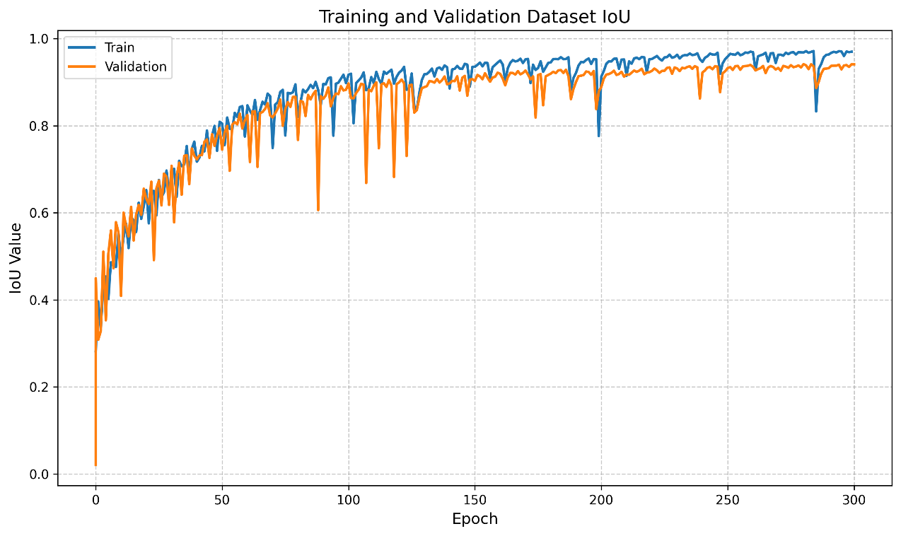
Training Results – CAS Landslide dataset (Satellite)
Dataset and Per Image IoU of Unet with DenseNet161 encoder, which is best performing model
AI-Powered Landslide Region Mapping using Semantic Segmentation | Hochschule Bielefeld | 04.09.2025 | Page 43
Notes:
HAW

Slide 44
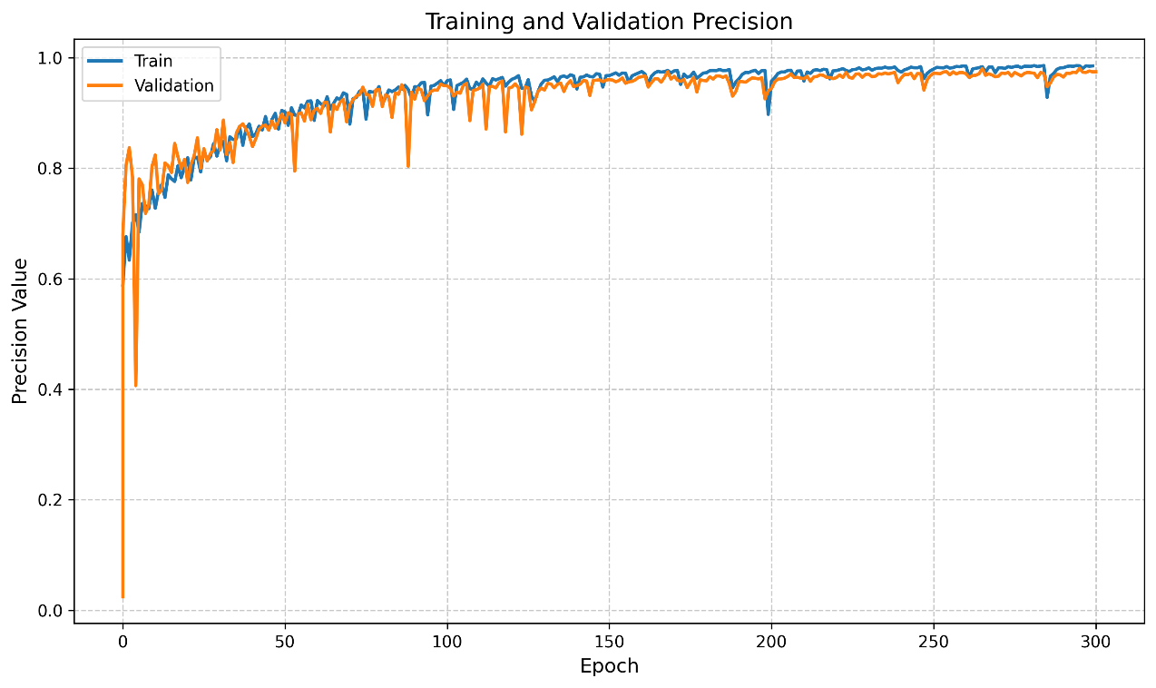
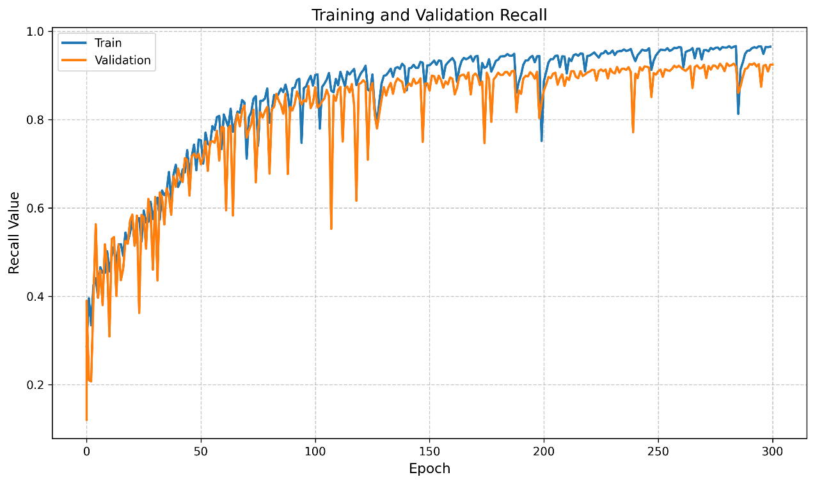
Training Results – CAS Landslide dataset (satellite)
Precision and recall of Unet with DenseNet161 encoder, which is best performing model
AI-Powered Landslide Region Mapping using Semantic Segmentation | Hochschule Bielefeld | 04.09.2025 | Page 44
Notes:
HAW

Slide 45
Evaluation Results – CAS Landslide dataset (Satellite)
Architecture | Backbone | Per-Image IoU | Dataset IoU | F1 Score | Accuracy | Recall | Precision
FPN | MobileNet | 0.6485 | 0.7968 | 0.8869 | 0.9813 | 0.7609 | 0.8892
 | ResNet18 | 0.7858 | 0.8609 | 0.9253 | 0.9889 | 0.8618 | 0.9293
 | ResNet50 | 0.8004 | 0.9023 | 0.9486 | 0.9915 | 0.8699 | 0.9511
 | Xception | 0.8366 | 0.9065 | 0.9509 | 0.9928 | 0.8801 | 0.9658
MANet | Xception | 0.8108 | 0.8830 | 0.9379 | 0.9909 | 0.8619 | 0.9566
 | EfficientNet-B2 | 0.7721 | 0.8645 | 0.9273 | 0.9892 | 0.8554 | 0.9259
 | MobileNetV2 | 0.7233 | 0.8412 | 0.9138 | 0.9866 | 0.8046 | 0.9258
 | ResNet50 | 0.7958 | 0.8781 | 0.9351 | 0.9905 | 0.8542 | 0.9495
PSPNet | EfficientNet-B2 | 0.5845 | 0.7234 | 0.8395 | 0.9776 | 0.6455 | 0.9008
 | MobileNetV2 | 0.5379 | 0.6757 | 0.8065 | 0.9712 | 0.6553 | 0.8060
 | ResNet50 | 0.6999 | 0.8291 | 0.9066 | 0.9855 | 0.7697 | 0.9194
 | Xception | 0.5555 | 0.6711 | 0.8032 | 0.9657 | 0.8729 | 0.7011
 | DenseNet161 | 0.6887 | 0.8285 | 0.9062 | 0.9845 | 0.7802 | 0.9077
Segformer | MobileNetV2 | 0.7326 | 0.8446 | 0.9157 | 0.9868 | 0.8119 | 0.9186
 | ResNet18 | 0.4301 | 0.5907 | 0.7427 | 0.9695 | 0.4316 | 0.9959
 | ResNet34 | 0.8074 | 0.9027 | 0.9489 | 0.9916 | 0.8607 | 0.9562
UNet | DenseNet161 | 0.8669 | 0.9305 | 0.9640 | 0.9944 | 0.9121 | 0.9704
 | MobileNetV2 | 0.7541 | 0.8516 | 0.9199 | 0.9883 | 0.8159 | 0.9410
 | ResNet50 | 0.8306 | 0.8979 | 0.9462 | 0.9921 | 0.8894 | 0.9549
 | Xception | 0.8172 | 0.8912 | 0.9425 | 0.9915 | 0.8793 | 0.9530
UNet++ | MobileNetV2 | 0.7212 | 0.8229 | 0.9029 | 0.9854 | 0.8113 | 0.8957
 | ResNet34 | 0.8640 | 0.9267 | 0.9620 | 0.9941 | 0.8953 | 0.9780
 | ResNet50 | 0.8574 | 0.9131 | 0.9546 | 0.9933 | 0.9086 | 0.9579
AI-Powered Landslide Region Mapping using Semantic Segmentation | Hochschule Bielefeld | 04.09.2025 | Page 45
Notes:
HAW

Slide 46
Evaluation Results – CAS Landslide dataset (Satellite)
Best Performing Models (Top-2) on CAS Landslide Dataset (Satellite Version)
Architecture | Backbone | Per-Image IoU | Dataset IoU | F1 Score | Accuracy | Recall | Precision
UNet | DenseNet161 | 0.8669 | 0.9305 | 0.9640 | 0.9944 | 0.9121 | 0.9704
UNet++ | ResNet34 | 0.8640 | 0.9267 | 0.9620 | 0.9941 | 0.8953 | 0.9780
5 Fold Cross Validation Result
Architecture | Backbone | Per-Image IoU | Dataset IoU | F1 Score | Accuracy | Recall | Precision
UNet++ | ResNet50 | 0.848454 | 0.925360 | 0.960543 | 0.994151 | 0.898619 | 0.968419
Due to large number of experiments; detailed results available at the link below.
https://drive.google.com/drive/folders/18iRsnAT7VtB0DBpdMv1XW5m5eAI67ml3?usp=sharing
AI-Powered Landslide Region Mapping using Semantic Segmentation | Hochschule Bielefeld | 04.09.2025 | Page 46
Notes:
HAW

Slide 47
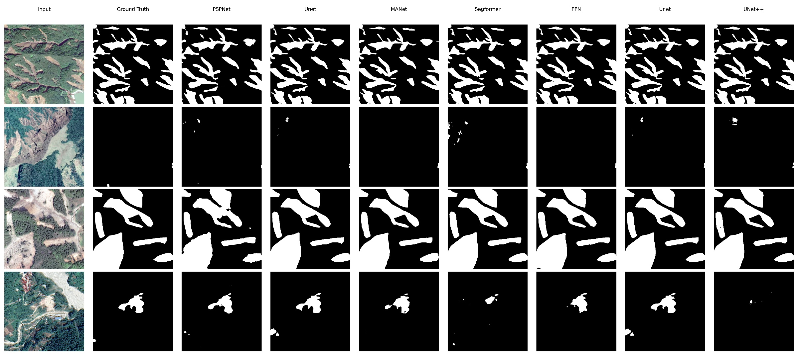
Sample predictions – CAS Landslide dataset (Satellite)
AI-Powered Landslide Region Mapping using Semantic Segmentation | Hochschule Bielefeld | 04.09.2025 | Page 47
Notes:
HAW

Slide 48
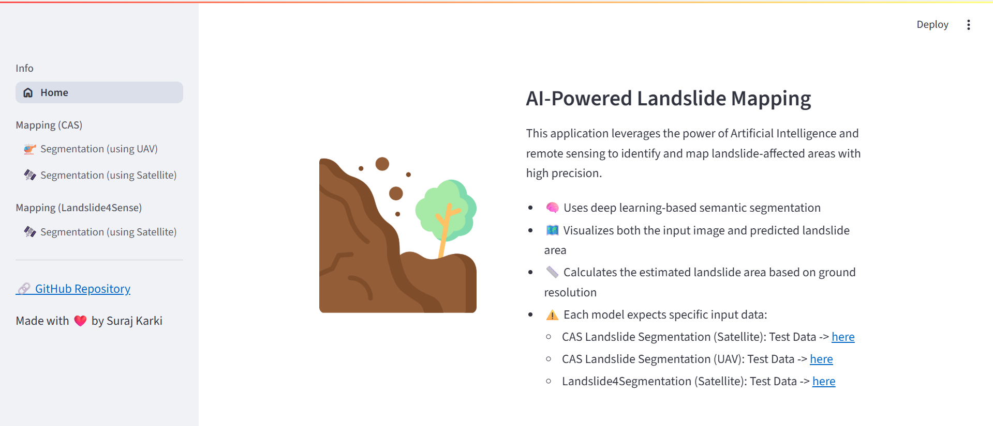
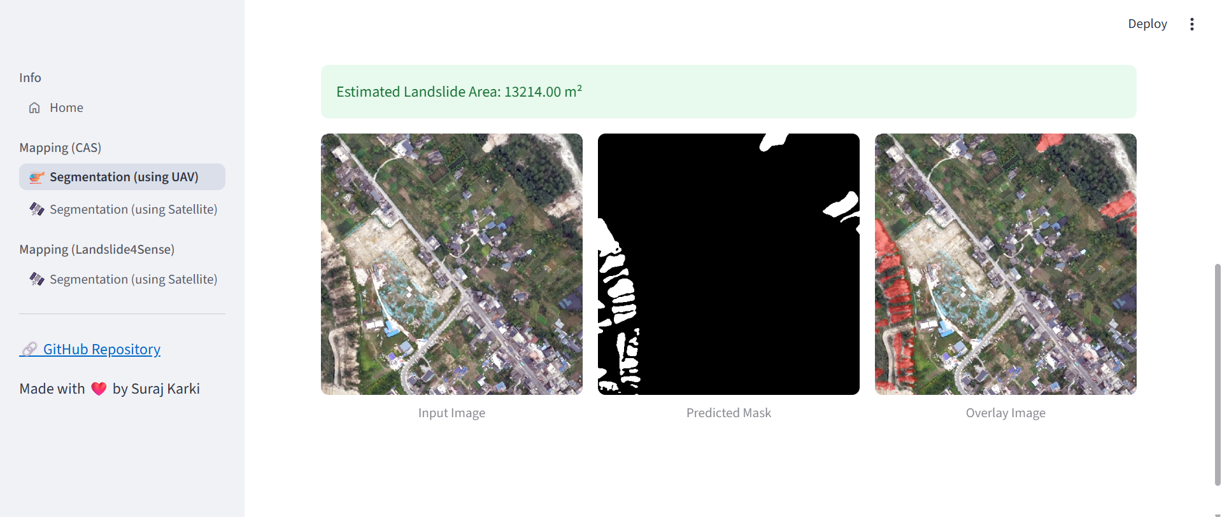
Deployment
After evaluation, the best performing model is exported in ONNX format.
Since, separate training is performed in three different datasets, three best performing model was exported.
The exported ONNX models are integrated into a Streamlit application.
AI-Powered Landslide Region Mapping using Semantic Segmentation | Hochschule Bielefeld | 04.09.2025 | Page 48
Notes:
HAW

Slide 49
discussion
Model Performance Analysis
High mIoU on CAS Landslide datasets (UAV: 95.19%, Satellite: 86.69%) due to high-resolution imagery and consistent annotations, surpassing benchmarks like Bijie (88.10%).
Lower performance on Landslide4Sense (44.44% vs. 76.07% SOTA) due to multi-spectral complexity, class imbalance, and small patch size.
Streamlit application performing inference efficiently for landslide segmentation on Landslide4Sense and CAS Landslide datasets.
AI-Powered Landslide Region Mapping using Semantic Segmentation | Hochschule Bielefeld | 04.09.2025 | Page 49
Notes:
HAW

Slide 50
discussion
Limitations
Uneven data distribution and fixed pre-trained encoders reduce adaptability, causing lower performance.
High-resolution CAS Landslide dataset caused GPU resource constraints, limiting training from scratch and further experiments.
Because of large model size latency is little bit high on CPU.
AI-Powered Landslide Region Mapping using Semantic Segmentation | Hochschule Bielefeld | 04.09.2025 | Page 50
Notes:
HAW

Slide 51
conclusion
Achieved up to 95.19% mIoU on UAV data;enabled precise post-disaster mapping.
Also, done experiments with multi-sensor datasets.
Deployed best performing model via Streamlit app.
Demonstrated potential for real-monitoring.
AI-Powered Landslide Region Mapping using Semantic Segmentation | Hochschule Bielefeld | 04.09.2025 | Page 51
Notes:
HAW

Slide 52
conclusion
Future Directions
Combining the CAS Landslide(UAV+Satellite) datasets to train and experiments with one ultimate landslide segmentation model.
For Landslide4Sense data, research on possible way to increase dataset, and training with different combination of loss function.
Perform model compression techniques(like quantization, distillation) to improve latency.
AI-Powered Landslide Region Mapping using Semantic Segmentation | Hochschule Bielefeld | 04.09.2025 | Page 52
Notes:
HAW

Slide 53

AI-Powered Landslide Region Mapping using Semantic Segmentation | Hochschule Bielefeld | 25.08.2025 | Page 53
Notes:
HAW

Slide 54

AI-Powered Landslide Region Mapping using Semantic Segmentation | Hochschule Bielefeld | 25.08.2025 | Page 54
Notes:
HAW

